Slide 1
Search Using Line Follow and Sound
By Nolan Bock, Connor Frazier, Matthew Pashkowsky, Andrew Wirth
Notes:
Presenter: Matt

Slide 2

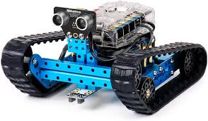
The Goal
Create control program for a robot to locate a sound source and navigate using line following
Build gazebo simulation of a physical robot and environment
Use the Makeblock mBot Ranger to test in a real world setting
Notes:
Presenter: Matt

Slide 3
The work required
Write custom firmware for mBot Ranger robot
Create serial communication library to control robot
Build Gazebo simulation of environment and robot
Design original Gazebo plugins to represent mBot ranger sensors
Implement line following algorithm
Implement sound mapping algorithm
Notes:
Presenter: Matt

Slide 4
The Expected Difficulties
The physical robot did not give precise (x,y) pose data
Controlling the mBot ranger from a different computer
Simulating mBot Ranger sensors
Mapping sound location
Turning at intersections
Space limitations and remote work
Notes:
Presenter: Matt
Make sure to mention how (x,y) was implemented (dead reckoning)

Slide 5
The Unexpected Difficulties
mBot documentation sparse
Extra new line characters in serial read
Bluetooth communication
Detecting turns when line following on ranger
No reasonable simulation for black tape (object interaction in Gazebo)
Single non-directional sound sensor and fluctuating sound
Batteries and cords
Notes:
Presenter: Connor
Batteries were bad for filming and we need lots

Slide 6

Changes In the plan
Line follow algorithm implementation
Adding (x,y) and heading angle to pose data
Removed the maze component in favor of manhattan style grid
Removed bluetooth from design
Notes:
Presenter: Connor

Slide 7
Interesting Components
Firmware for mBot
Serial communication
Single brain, multiple executables for different environments
Sound plugin
Line follow plugin (camera)
Sound sensor data - moving averages
Notes:
Presenter: Connor

Slide 8
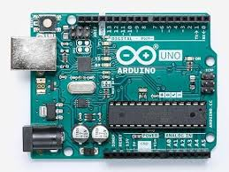
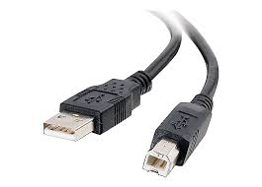
Ranger firmware + Serial Communication
Research accessing sensors and actuator on mBot Ranger
Firmware to parse commands and arguments
Execute action commands
Respond to sensor read requests
Notes:
Presenter: Connor

Slide 9
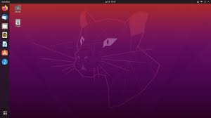
Project Architecture + Serial Communication
Serial Communication: Create connection, read, and write
Abstract firmware protocol to simple methods in a c++ library
Create two robot classes to use one brain (including adapters)
Notes:
Presenter: Connor

Slide 10
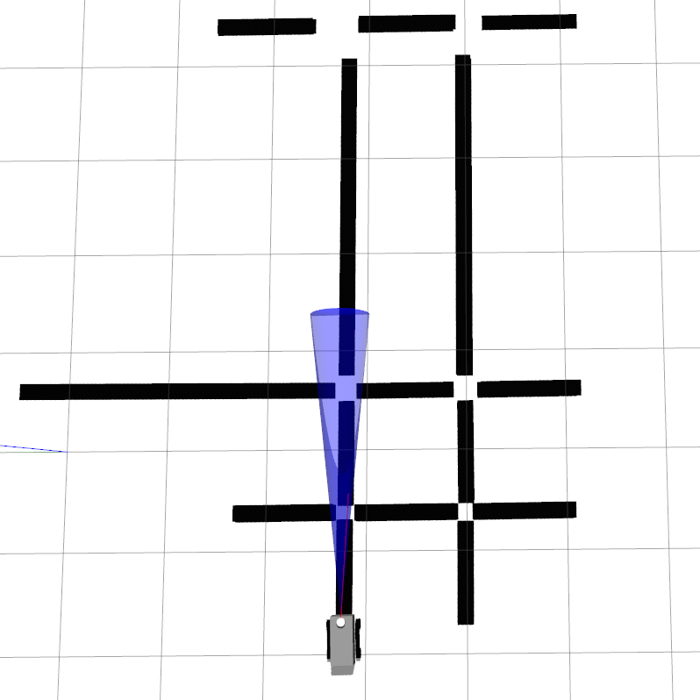
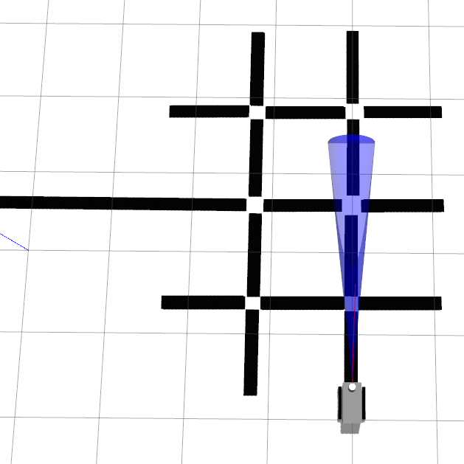
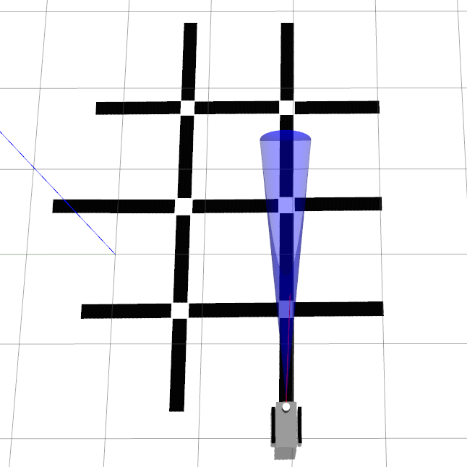
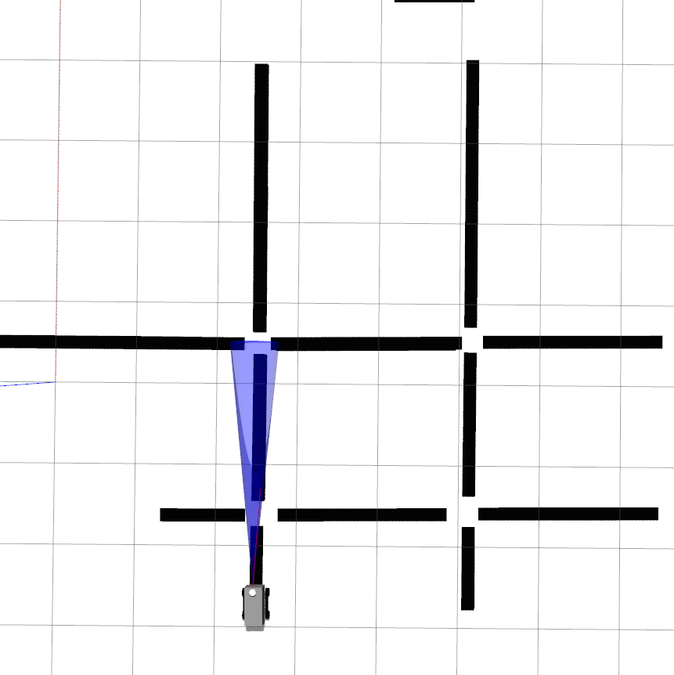
Interesting Components: Gazebo maps
Notes:
Presenter: Nolan

Slide 11
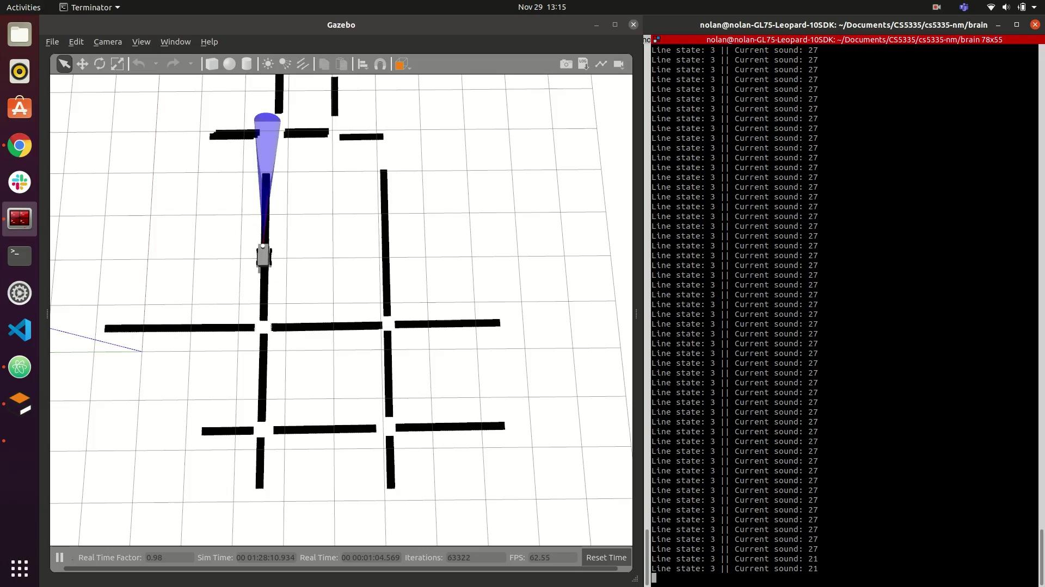
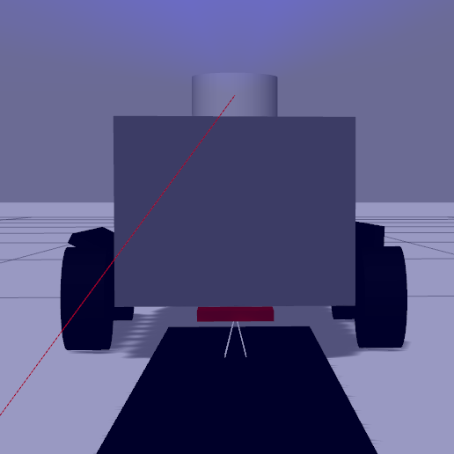
Interesting Components: Gazebo plugins
Custom Gazebo plugins allowed us to simulate controls on the ranger with reasonable accuracy
Notes:
Presenter: Nolan

Slide 12
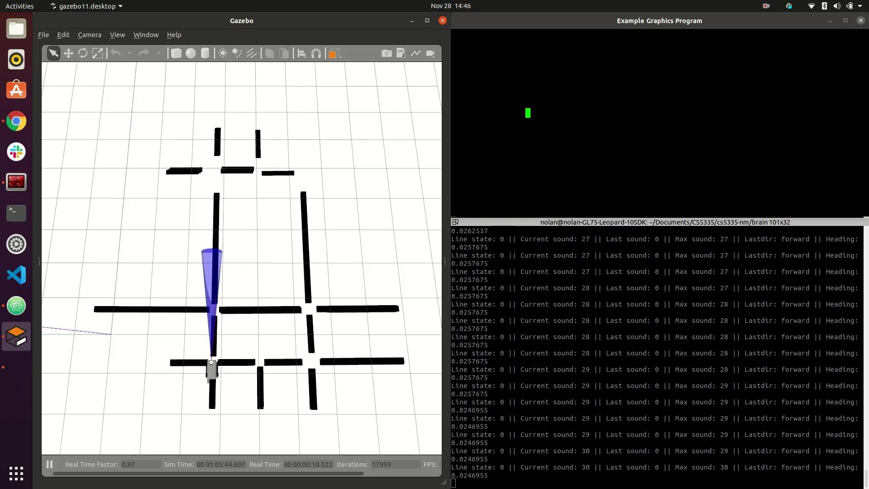
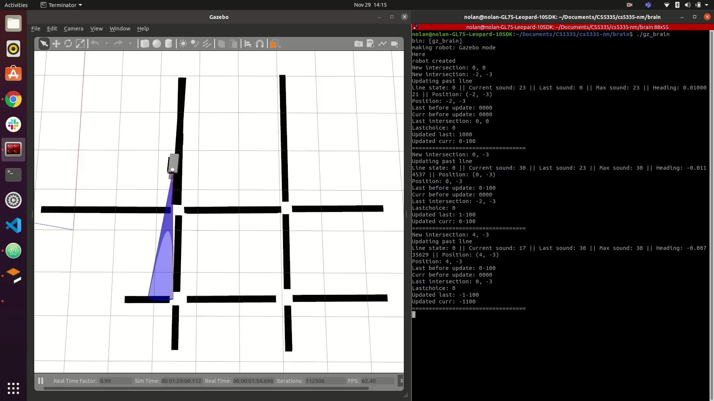
Interesting Components: simulating controls
A simulator with full sensors allowed us to experiment with different strategies
Decisions are made every callback about what to do
Passively line follow but only makes turning decisions at intersections
Notes:
Presenter: Nolan

Slide 13
Interesting Components: simulating tape
Simulating tape was a challenge because of how it interacted with the treads
We experimented with hard coding a path without using the camera
Tape being pulled by the treads
Tape being pushed below ground
Notes:
Presenter: Nolan

Slide 14
Connecting Components Together
The Gazebo plugins were added to the sim
The ranger robot class used the serial communication library
Two robot classes were created to be used with one brain program
The algorithms were implemented in the brain unaware of the type of robot it was interacting with
Notes:
Presenter: Andrew

Slide 15
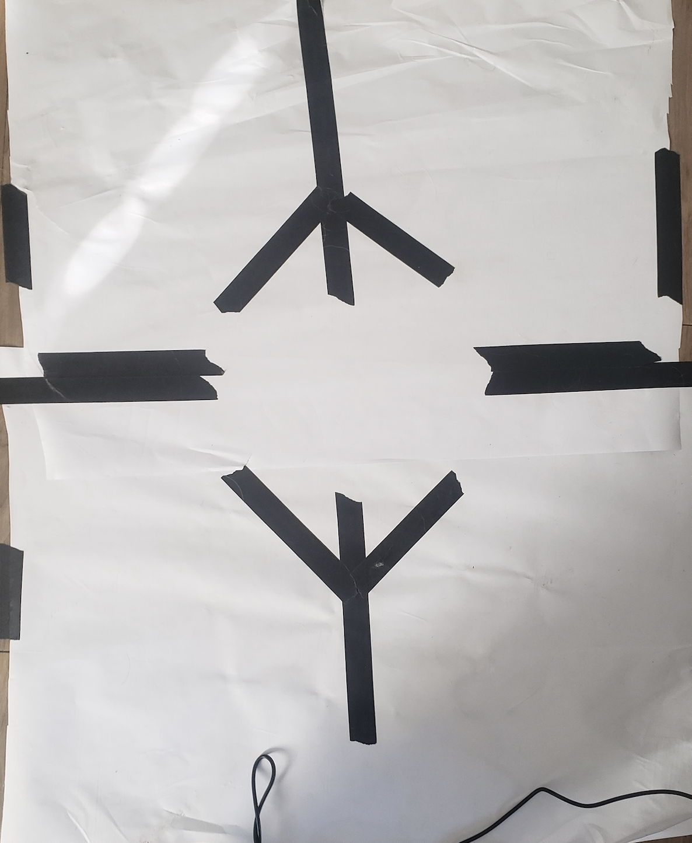
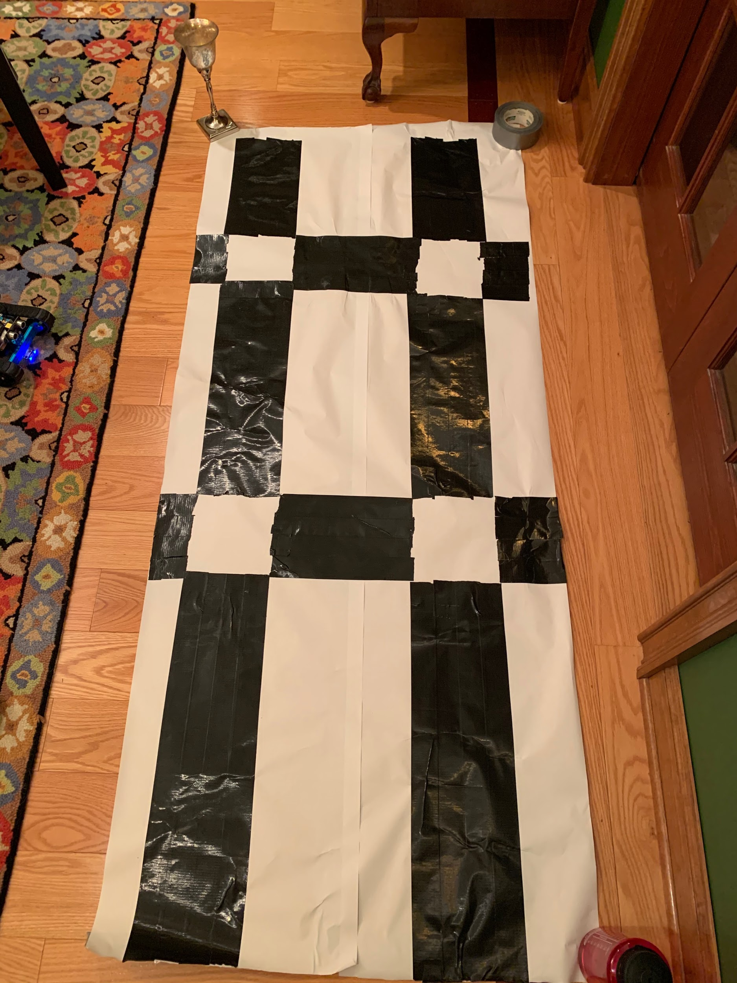
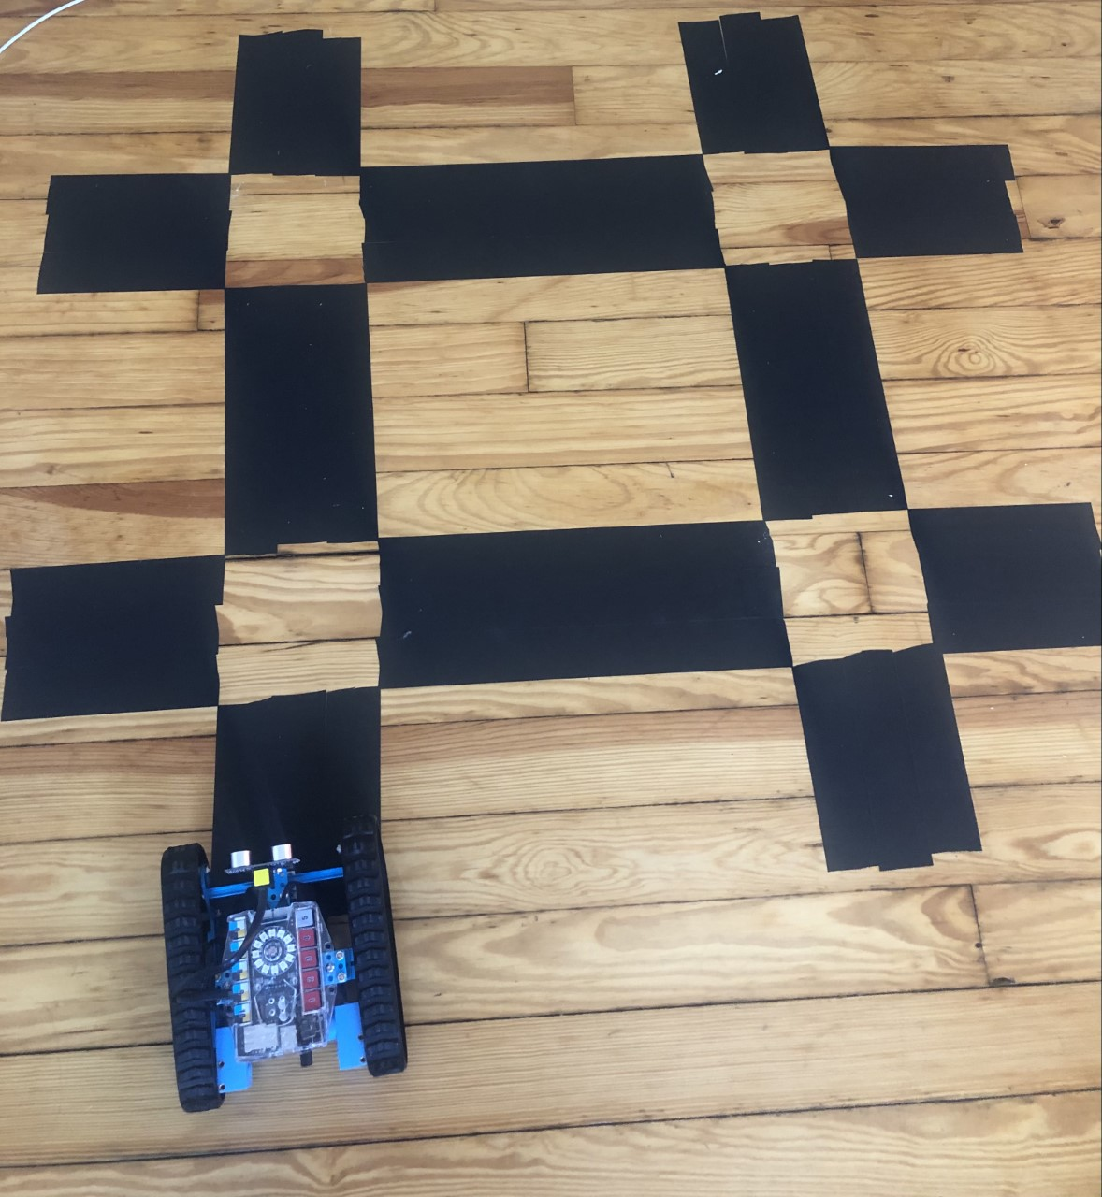
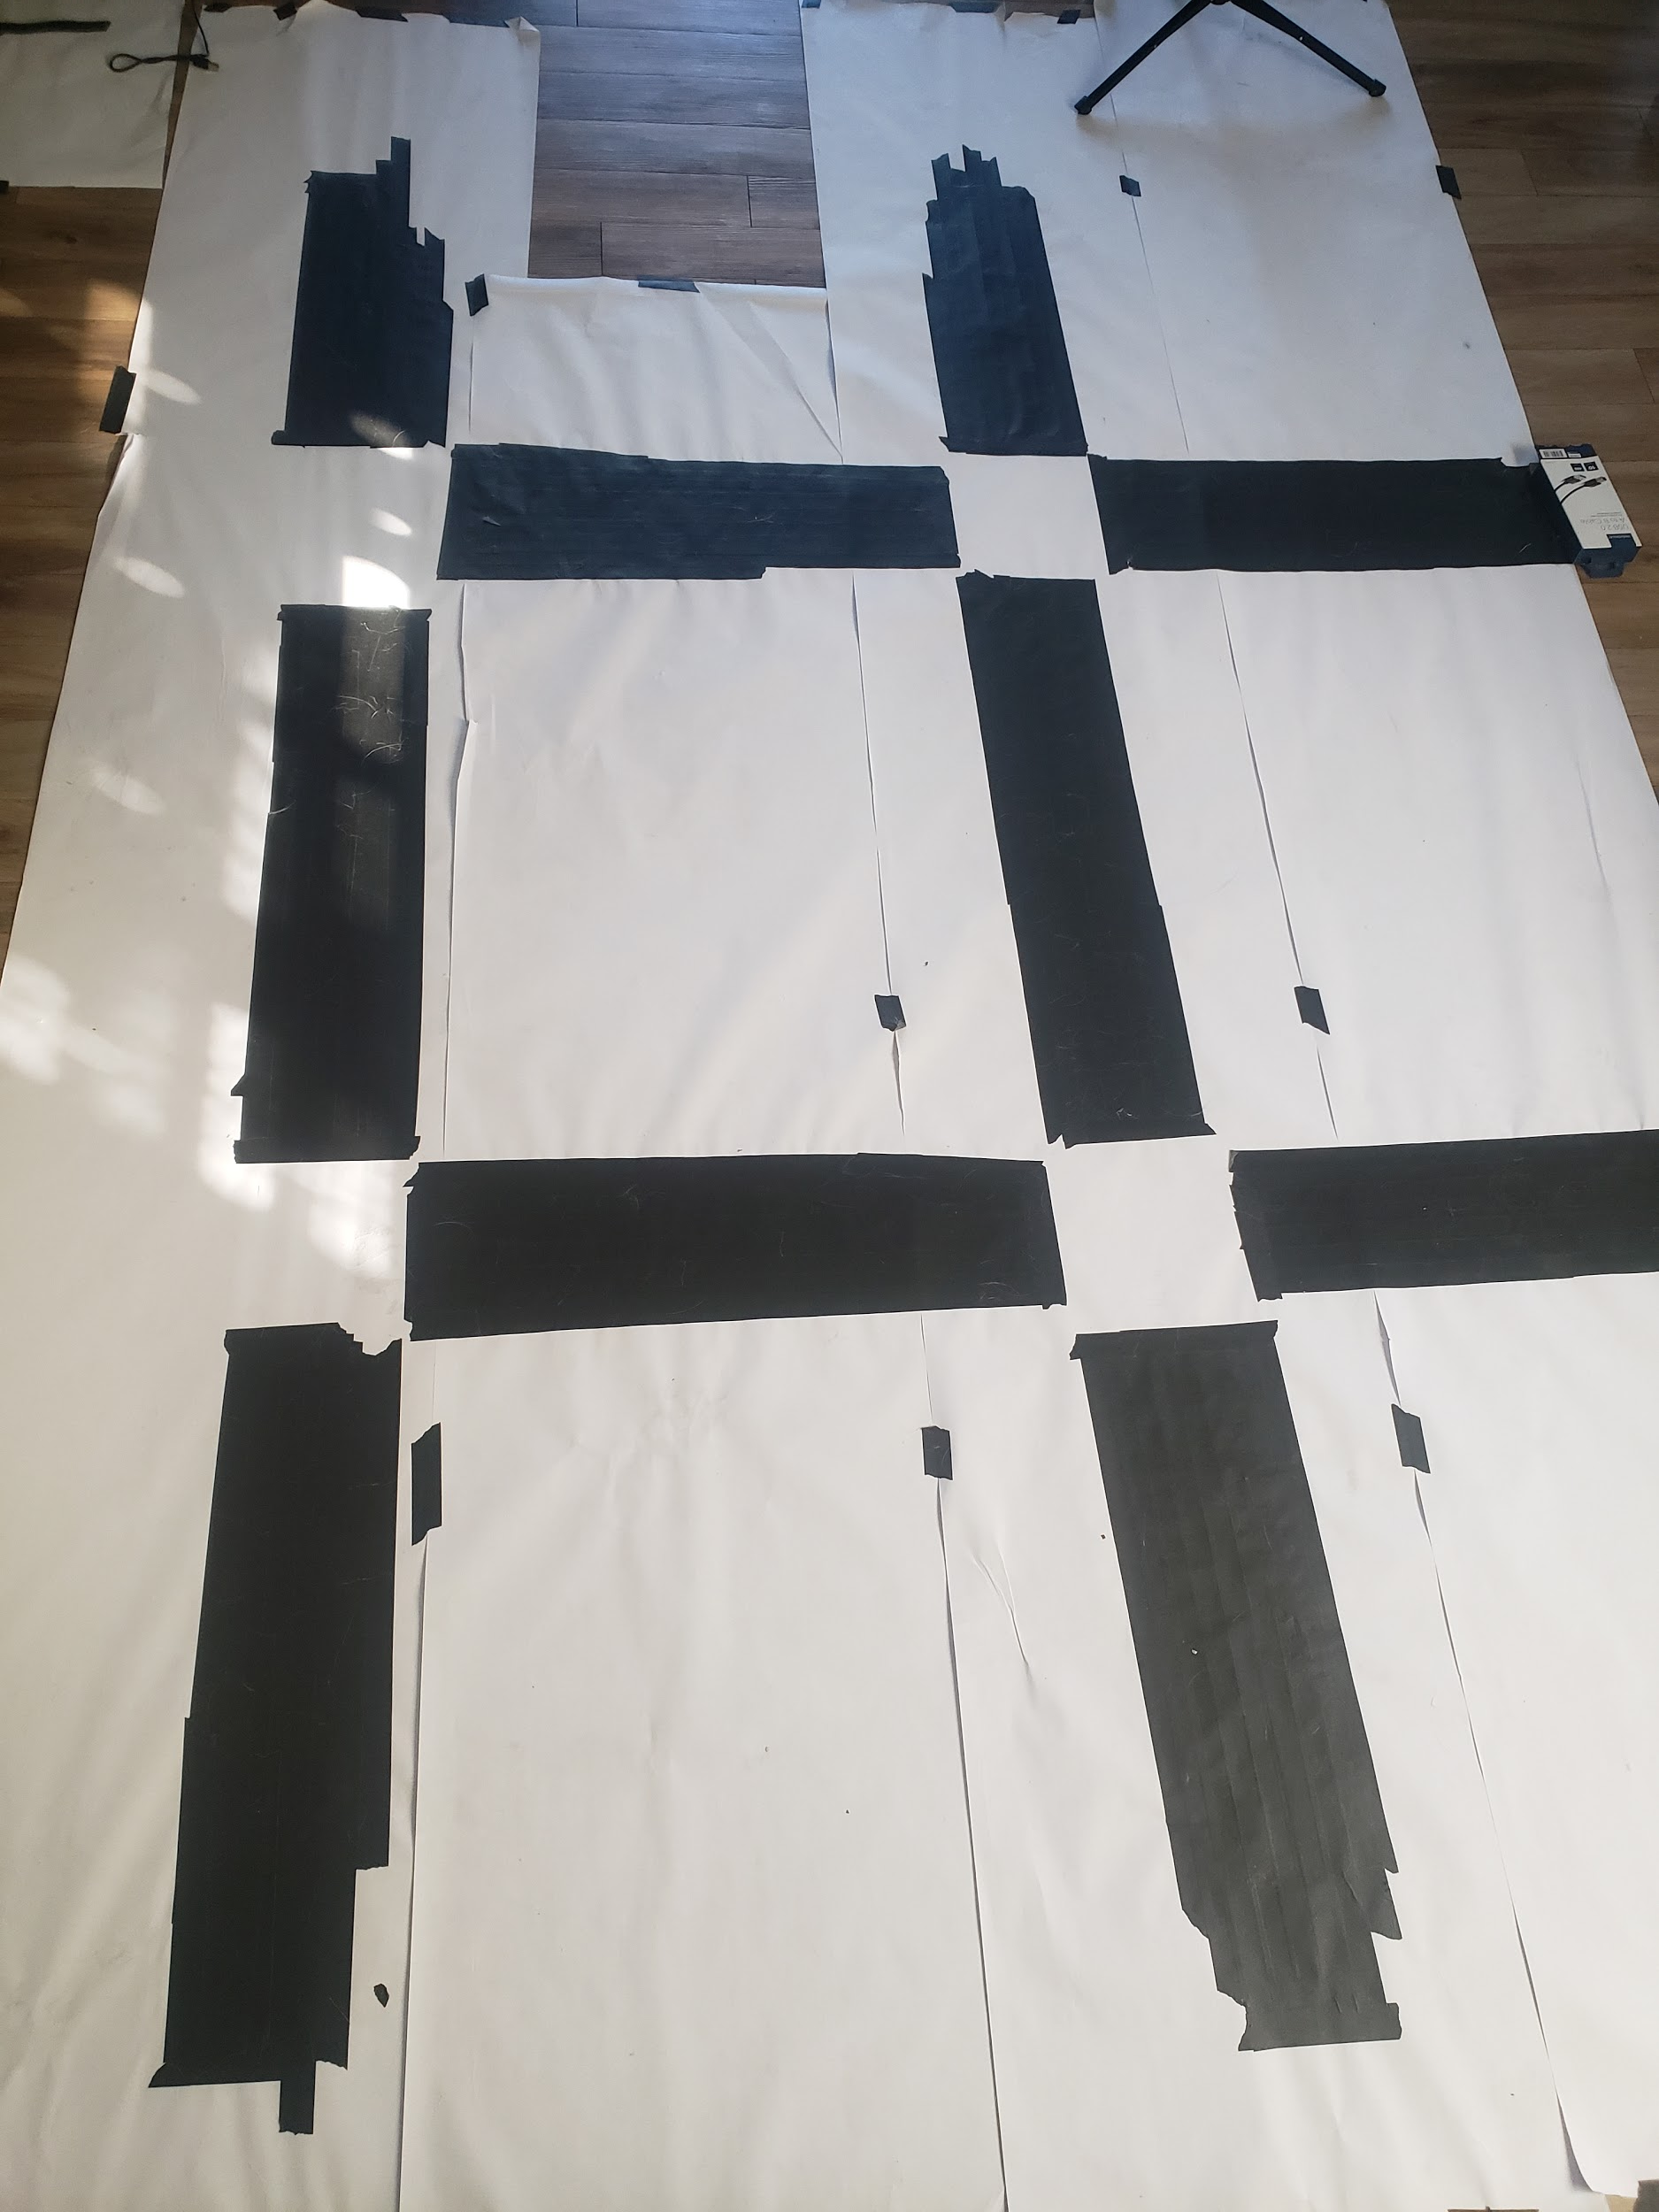
Physical Testing Environments
Notes:
Presenter: Andrew

Slide 16
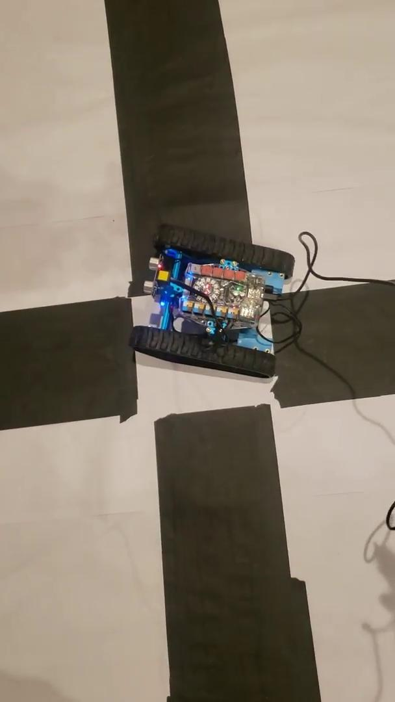
The Demo Results
Notes:
Presenter: Andrew

Slide 17
Academic Paper Technique
“Auditory Occupancy Grids with a Mobile Robot”
Provides heuristic for robot at intersections
“Algorithm for Line Follower Robots to Follow Critical Paths with Minimum Number of Sensors”
Used as inspiration for creating our line follow
Exploring Light Brightness and the Inverse-Square Law 3
Repurposed for sound which behaves the same
Notes:
Presenter: Andrew

Slide 18
Thank You For Watching
Questions?
Notes:
Presenter: Andrew

